Slide 1
Expression Parser
Data Structures
Contributor:
Muhammad Osama Irfan (21k-4772)

Slide 2
Introduction:
The way to write arithmetic expression is known as a notation. An arithmetic expression can be written in three different but equivalent notations, i.e., without changing the essence or output of an expression.
These notations are:
Infix Notation
Prefix Notation
Postfix Notation

Slide 3
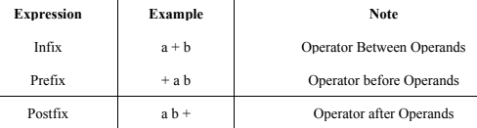
Example:
Generally, postfix expressions are free from Operator Precedence that's why they are preferred in
Computer system. Computer System Uses Postfix form to represent expression.

Slide 4
Parsing Expressions:
As we have discussed, it is not a very efficient way to design an algorithm or program to parse infix notations. Instead, these infix notations are first converted into either postfix or prefix notations and then computed or evaluated.
To parse any arithmetic expression, we need to take care of operator precedence and associativity also.
Precedence:
When an operand is in between two different operators, which operator will take the operand first, is decided by the precedence of an operator over others. For example:
a + b * c ⇨ a + ( b * c )
As multiplication operation has precedence over addition, b * c will be evaluated first.

Slide 5
Parsing Expressions:
Associativity:
Associativity is the left-to-right or right-to-left order for grouping operands to operators that have the same precedence. For example:
In expression a + b − c, both + and – have the same precedence, then which part of the expression will be evaluated first, is determined by associativity of those operators.
Here, both + and − are left associative, so the expression will be evaluated as (a + b) − c.

Slide 6
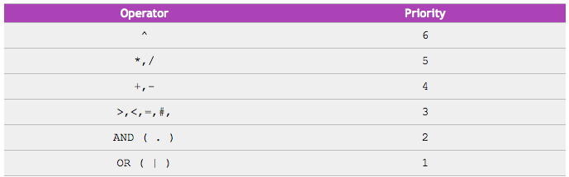
Operator Precedence:

Slide 7
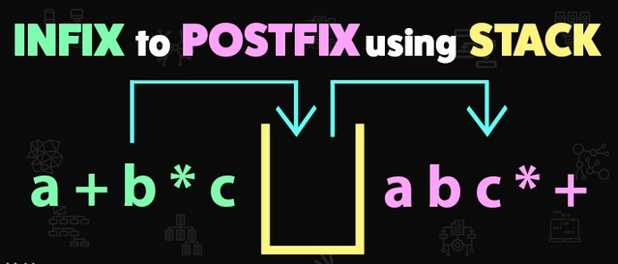
Postfix Evaluation Algorithm:
Step 1 − scan the expression from left to right
Step 2 − if it is an operand push it to stack
Step 3 − if it is an operator pull operand from stack and perform operation
Step 4 − store the output of step 3, back to stack
Step 5 − scan the expression until all operands are consumed
Step 6 − pop the stack and perform operation

Slide 8
Thank you!
Moving towards the Code…
Contributors:
Muhammad Osama Irfan (21k-4772)
Muhammad Taha Qaiser (21k-4779)

